Slide 1
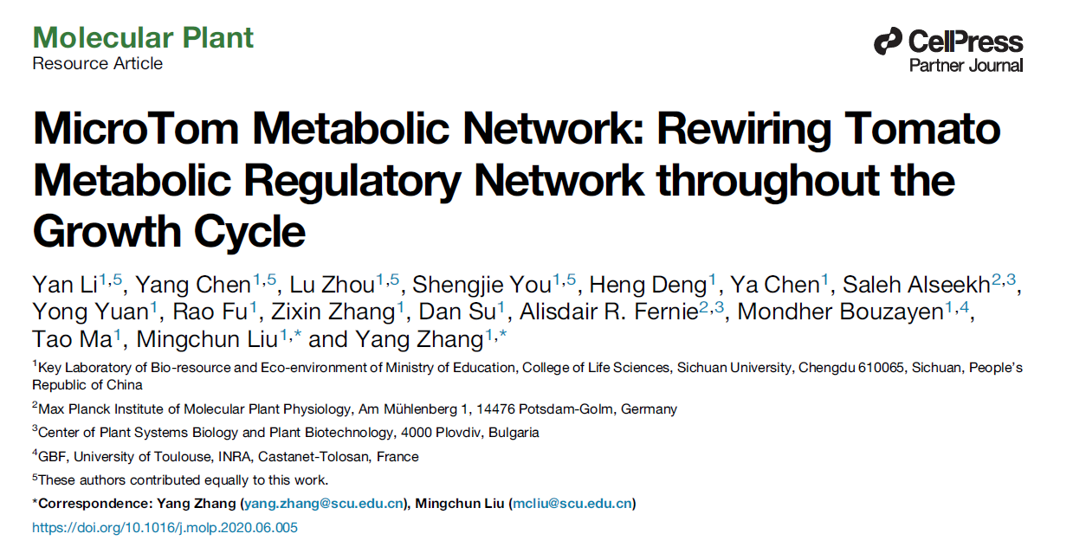

Slide 2
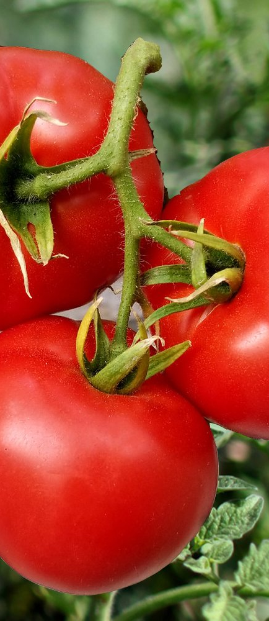
Introduction
S. lycopersicum is a model system for secondary metabolism
Secondary metabolites are important for plant and human health
Plant – signaling & defense
Human – anti-cancer, antioxidant, etc.
Most studies of tomato metabolism focus only on
A single growth stage
A single tissue (mostly fruit)
Changes in plantwide metabolism over lifecycle (and its underlying transcriptional regulation) are largely unknown

Slide 3
Overview
Separate plant into 20 tissues/growth stages
Collect data at each stage
Transcriptomic data by RNAseq
Metabolomic data by LC-MS – flavonoids & steroidal glycoalkaloids (SGAs)
Integrate datasets to construct network
Validate network by identifying known transcription factors
Use network to identify novel transcription factors
Validate TFs with wet lab techniques

Slide 5
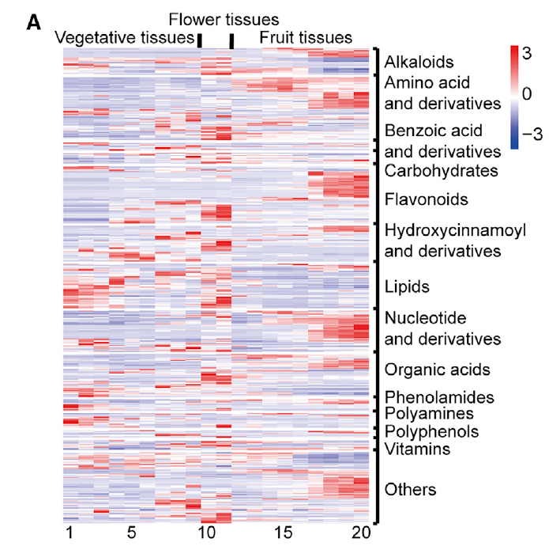
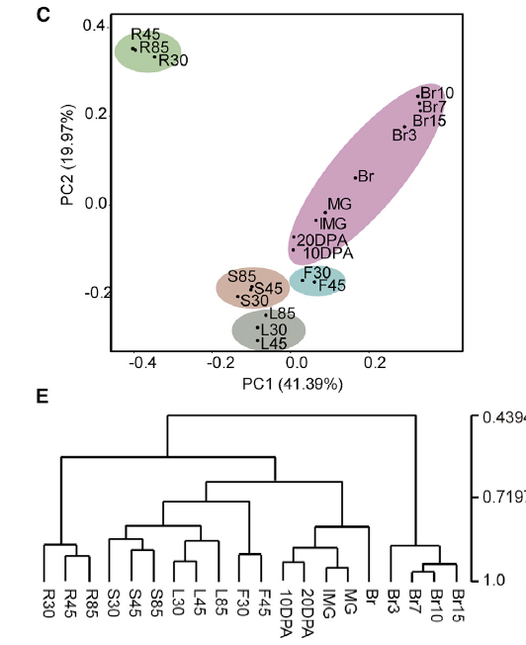
Roots
Fruit
Stems
Flowers
Leaves

Slide 6
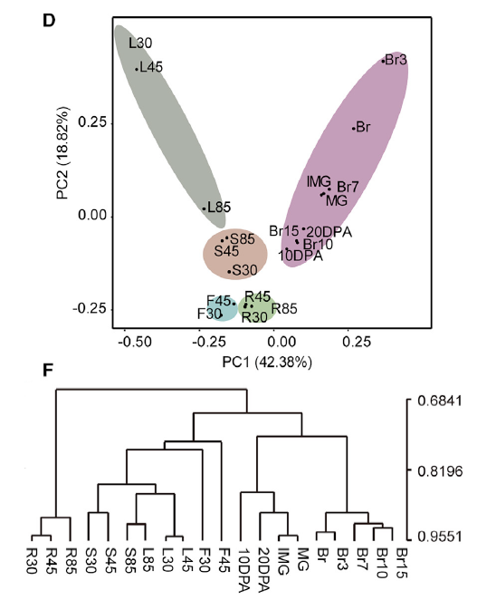
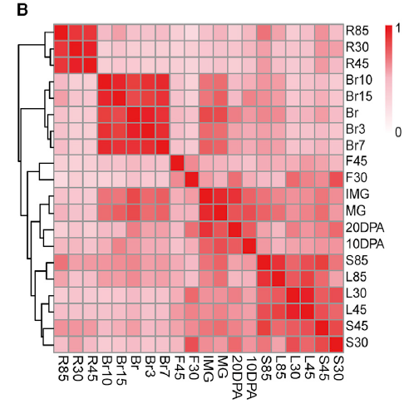

Slide 7
Metabolites
Genes coexpressed w/ a least 1 metabolite
Enriched in roots
Enriched in stems
Enriched in leaves
Enriched in flowers
Decreased during period between flowering and fruit ripening stages
Increased during green fruit stages
Encriched during fruit ripening stages

Slide 8
Metabolome
Transcriptome
Metabolome
Transcriptome

Slide 10
Known transcription factor - SlGAME9

Slide 11
SlbHLH114
SlGAME9

Slide 14
SIERF.G3-Like
SIMYB12

